Slide 1
The DfE QA log app
Behind the code

Slide 2
Contents
How does the QA log app work?
How to add a new check
How to add a new log

Slide 3
How does the QA log app work?
Key:
Comments
Tooltips
Can be edited to add new checks/new logs
comments_modelling_log.R
tooltips_modelling_log.R
Shouldn’t be edited
Functions
edit_lists.R
comments_analysis_log.R
tooltips_analysis_log.R
UI
Server
main_ui.R
functions_for_ui.R
main_server.R
comments_dashboard_log.R
tooltips_dashboard_log.R
home_ui.R
functions.R
home_server.R
comments_statistics_log.R
tooltips_statistics_log.R
app.R

Slide 4

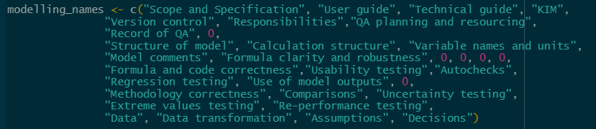
How to add a new check (1/4)
In edit_lists.R:
Add the check ID to QAcheckslist
Add the check name to each individual _names list:
The order of check names should follow the same order as QAcheckslist
If the check is not part of that log, put a 0 in the correct place

Slide 5

How to add a new check (2/4)
In edit_lists.R:
Update each individual _mandatory list:
The order of mandatory checks should follow the same order as QAcheckslist
If the check is mandatory, put a 1
If the check is not mandatory, put a 0

Slide 6
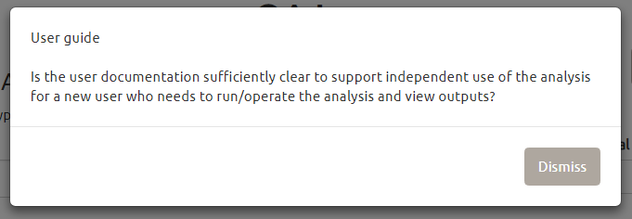
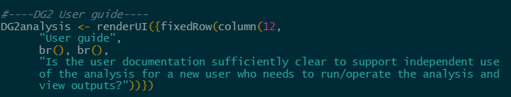

How to add a new check (3/4)
Example:
In each of the comments_..._log.R files:
Add information to appear in window when clicking on check
Name the information “checkID”“logname” where logname is the one-word name given in logslist (see edit_lists.R)
Then put <- renderUI({fixedRow(column(12,
Enter the name of the check, followed by br(), br(),
Then put any comments. Comments can be split over multiple rows by closing inverted commas and then using br()
At the end, make sure inverted commas are closed and all brackets are closed.
This will need to be done on ALL comments files.
If the check is not required for a log, then put:
(it is important that all of these objects are defined, regardless of if check is required or not)

Slide 7
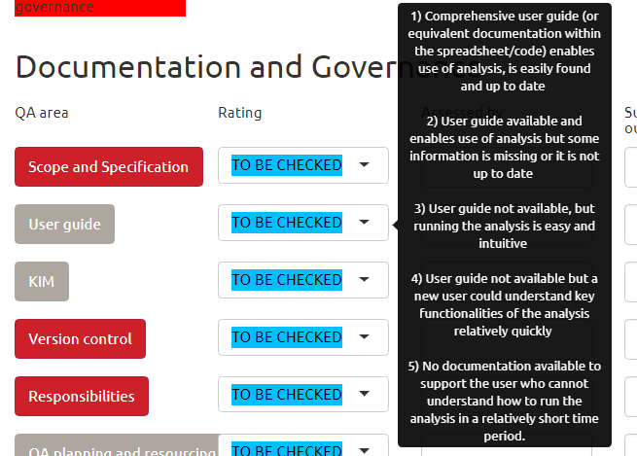


How to add a new check (4/4)
Example:
In each of the tooltips_..._log.R files:
Add information to appear when one hovers over the scoring menu
Name the information “checkID”tooltip“logname” where logname is the one-word name given in logslist (see edit_lists.R)
Then put <- and open inverted commas
The entire code must be written on one line (since R doesn’t seem to like putting things over multiple lines)
When displaying the code, to skip lines between scores, simply put <br> <br>
This will need to be done on ALL tooltips files.
If the check is not required for a log, then put:
(it is important that all of these objects are defined, regardless of if check is required or not)

Slide 8
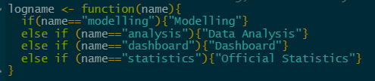
How to add a new log (1/5)
In edit_lists.R:
Update logslist with a one word name for the log:
Update logname with the proper name for the log (can be as many words as you like!)

Slide 9
How to add a new log (2/5)
In edit_lists.R:
Add a new _names list, including names for all relevant checks, and a 0 for those not included in the log:
Add a new _mandatory list, including a 1 for all mandatory checks, and a 0 for others
The order of check names should follow the same order as QAcheckslist
If the check is not part of that log, put a 0 in the correct place
The order of mandatory checks should follow the same order as QAcheckslist
If the check is mandatory, put a 1
If the check is not mandatory, put a 0

Slide 10
How to add a new log (3/5)
In edit_lists.R:
Add the _names and _mandatory lists to the names_df dataframe:
Just put both names in here!

Slide 11
How to add a new log (4/5)
Example:
You will need to create a new file in the “tooltips” folder
This should be entitled “comments_..._log.R” with the ellipsis replaced by the name of the new log (from logslist in edit_lists.R)
You now need to input comments for each check following this format:
If the check is not required, then put this:
(it is important that all of these objects are defined, regardless of if check is required or not)

Slide 12
How to add a new log (5/5)
Example:
You will need to create a new file in the “tooltips” folder
This should be entitled “tooltips_..._log.R” with the ellipsis replaced by the name of the new log (from logslist in edit_lists.R)
You now need to input tooltips for each check following this format:
The entire code must be written on one line (since R doesn’t seem to like putting things over multiple lines)
When displaying the code, to skip lines between scores, simply put <br> <br>
If the check is not required, then put this:
(it is important that all of these objects are defined, regardless of if check is required or not)

Slide 13
Further details on how the code works

Slide 14
Map for creating new log Mostly from home_server.R
We have a list “types” containing the reactive value “log”. Initially this is set to:
types$log = “blank”
Similarly, lists “unsure” and “nexttab” containing reactive value “log”
Select create new log
A new panel is shown with following options:
Runs the “create_log” function:
Generates random 4-digit project ID
Checks that this isn’t already assigned to another project
Updates “projectID” and “QAlogtype”
Switches to new tab
unsure$log = “blank”
types$log = “modelling”
nexttab$log = “blank”
types$log = “analysis”
types$log = “new”
types$log = “dashboard”
Modelling
A new panel is created containing:
types$log = “statistics”
Data Analysis
nexttab$log = “next”
A new panel is created containing:
Dashboard
Submit project ID
Official Statistics
Submit QAlogtype
Error message (initially blank)
Unsure which to use?
unsure$log = “unsure”
More info is shown about each log
Back
types$log = “blank”
Back
unsure$log = “blank”
These panels are not accessible for the user since the tab has already been switched – but it is necessary to create the projectID and QAlogtype input boxes

Slide 15
Map for updating existing log Mostly from home_server.R
We have a list “types” containing the reactive value “log”. Initially this is set to:
types$log = “blank”
Similarly, lists “unsure” and “nexttab” containing reactive value “log”
Select update existing log
A new panel is shown with following options:
Reads in info from SQL QA_log database
unsure$log = “blank”
If no corresponding project ID, display error message
nexttab$log = “blank”
types$log = “update”
Else:
Update projectname, version, leadanalyst, analyticalassurer, BCM and QAlogtype from SQL data
Switch tab
nexttab$log = “next”
A new panel is created containing:
This panel is not accessible for the user since the tab has already been switched – but it is necessary to create the QAlogtype input box
Submit project ID
Error message (initially blank)
types$log = “modelling” etc.
Submit QAlogtype
Back
Reads in info from SQL QA_checks database
Runs the update_checks function:
Runs through list of all checks
If no corresponding row in SQL, sets rating to “TO BE CHECKED”
Else:
Updates score, as well as other boxes, using data from SQL
This is done using the readingOutput function:
If score = 1, set rating to be “Excellent”
If score = 2, set rating to be “Good”
Etc.
types$log = “blank”
unsure$log = “blank”

Slide 16
Some more detail on UI_check
UI_check creates the following UI objects: (for all check IDs and log types)
DG1infomodelling
scoreDG1
assessDG1
summaryDG1
obsDG1
outDG1
Text inputs for “Assessed by”, “Summary of/link to QA outcome or evidence”, “Observations” and “Outstanding (potential) work”
Action button – pressing this gives you more information on how to complete the check
This is done via the create_modal function:
Creates modalDialog with UI output DG1modelling (for example – this would be taken from the “comments_modelling_log.R”)
Created using rating_options function:

Slide 17
Checking whether data has been saved
To give a warning message “You have unsaved changes!” we create two dataframes – one from SQL data, one from current app status – and compare the two.
Updates automatically as changes made in app
Reading in from SQL:
Obtain projectID from app
Find relevant row in dbo.QA_log
If row doesn’t exist (i.e. brand new log, never been saved before), create a row of blank data
Select all relevant rows in dbo.QA_checks (there will be one row for each complete check)
Where a row doesn’t exist for a check, create a row of blank data
We merge this together into a dataframe
Has to be updated manually
Reading in from app:
Manually create row that matches row in dbo.QA_log
Use paste_other_input to create row that matches those in dbo.QA_checks
This is run over all check IDs using sapply function
Everything merged together into one dataframe
Blank rows are necessary so that both dataframes are same size to allow us to compare
Example of first three columns of dataframe:
Project ID | Project ID | Project ID
Project name | DG1 | DG2
Version | DG1 rating | DG2 rating
Lead Analyst | DG1 assessor | DG2 assessor
Analytical Assurer | DG1 Evidence | DG2 Evidence
BCM? | DG1 Observations | DG2 Observations
Log type | DG1 Outstanding | DG2 Outstanding
Dataframes are compared.
If not equal, an error message is printed.
Whenever “Save” button is pressed, the “Reading in from SQL” is repeated, and comparison is run again.

Slide 18
Saving score function
This is to save scores for different QA checks to SQL. We read in current SQL data, and current app data.
Does row for corresponding SQL data exist?
Yes
Data hasn’t been updated. Do nothing.
Yes
Is app data equal to SQL data?
No
No
App data has been updated.
Copy data from SQL to SCD database.
Overwrite data in SQL with current app data.
Yes
Data hasn’t been added for this check. Do nothing.
Is app data blank?
No
This is new data.
Add a new row to SQL database.
Add a row to SCD database with “TO BE CHECKED”

Slide 19
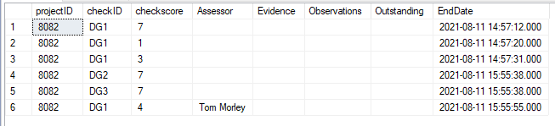
Reading in from SCD tables
(Slowly Changing Dimensions)
This is the END date – the date the data changed from the checkscore value
This is what the SCD table for the QA checks looks like:
At 14:57:12, DG1 is marked 1.
At 14:57:20, DG1 is changed to 3.
At 14:57:31, DG1 is changed to 4.
At 15:55:38, DG2 and DG3 are changed.
At 15:55:55, DG1 is changed.
The current values are not given in the SCD table – these are kept in the QA_checks table

Slide 20
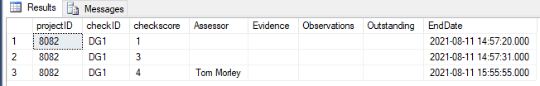
Reading in from SCD tables
We want to read in DG1 at 14:57:12.
So set dateselect = 14:57:12 (from shiny app).
Then
SELECT * FROM [databasename].[dbo].[QA_checks_SCD]
Where checkID = 'DG1'
And EndDate > '2021-11-08 14:57:12'
The first row gives us the result we want.

Slide 21
Reading in from SCD tables
Enter project ID, checkID and search SCD table for EndDate > SelectedDate
Table contains zero rows
Enter project ID and checkID and search QA_checks table
Table contains zero rows
Enter empty row
Table contains one or more rows
Data has never been updated, so check will still be marked “TO BE CHECKED”
Table contains one row
Select top row from table
This is relevant data
This is data that has been entered into this check most recently at selected date
Data has not been updated since selected date, so current data still relevant

